Slide 1

Oracle of Nonsense
Mark Staten, Jacob Edelbrock, Gerald Howard

Slide 2
Your best quote that reflects your approach… “It’s one small step for man, one giant leap for mankind.”
- Neil Armstrong

Slide 3
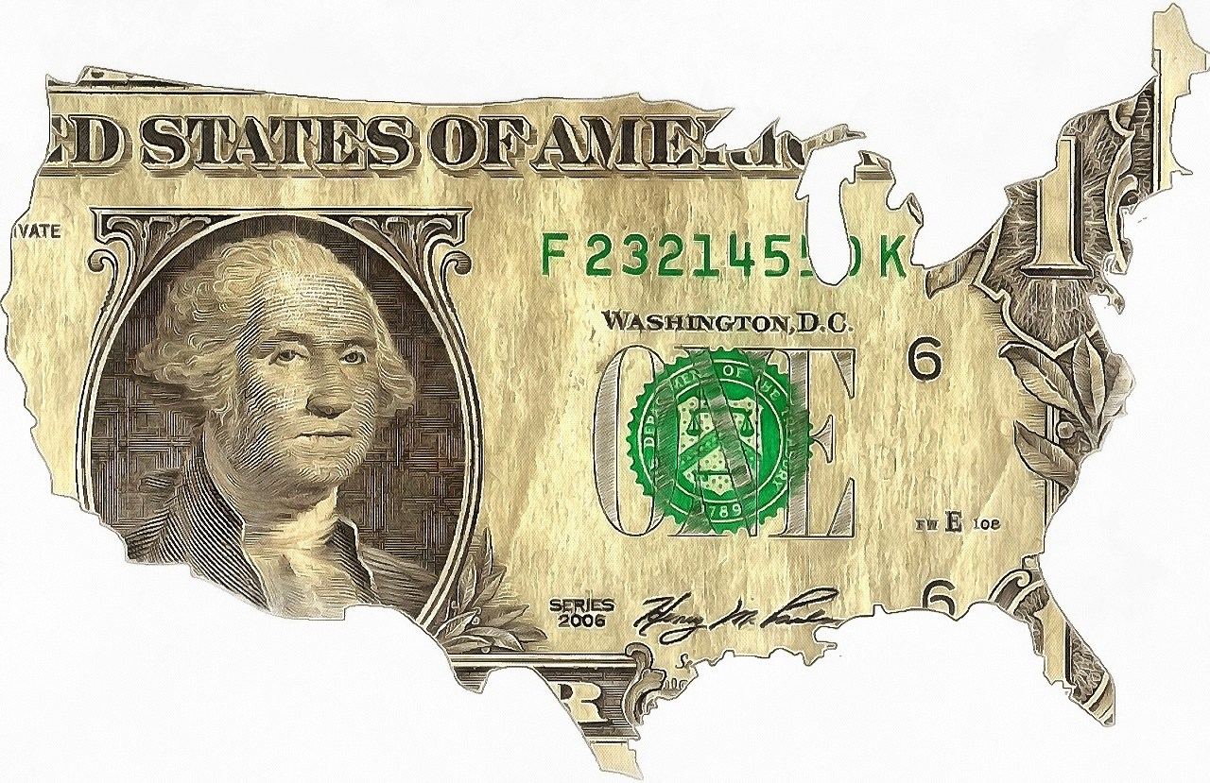
Objectives
Our project incorporates historical data and consumer sentiment to provide future predictions of different asset classes in the American economy. We can then visualize these predictions as trends and use this information to make informed investment decisions.

Slide 4

Concepts
By incorporating machine learning and analyst sentiments as data inputs into our machine learning algorithm, we then to trained and tested our model based on historical data. From the model training and testing, we can then run our model to receive a prediction. Using data visualization, we can show and explain our results to stakeholders and others who would be interested in our predictions.
This Photo by Unknown Author is licensed under CC BY

Slide 5

Data techniques
This Photo by Unknown Author is licensed under CC BY-SA-NC

Slide 6

approach
This Photo by Unknown Author is licensed under CC BY-ND

Slide 7
demonstration

Slide 8
Next steps

Slide 9
Links

